Slide 1

Data Mining
represented by:
Aleksandra Petkova - S6222041
Nour Aldin ALMUBARAK- p4302185

Slide 2
Datasets
Online Retail: time series, transactional data – 8 attributes, 541K records
Each row represents a whole sale purchase of an item along with details about the purchase such as: the invoice ID, stock code, item description, quantity purchased, price per unit, the ID and country of the customer who made the purchase.
Groceries: customer recite data – 9K records
Each row represents a customer recite (list of the items bought) with no details about the purchase but the names of the items.
MovieLands: movie rating data – 100K records describes a movie recommendation service. It contains 100836 ratings and 3683 tag applications across 9742 movies. The data contains ratings from 610 unique users made between March 29, 1996 and September 24, 2018. The dataset was generated on September 26, 2018.
Notes:
This is a list of all the datasets used throughout the project. Online Retail (Point to the paragraph about it) – Used for both the algorithm written from scratch and the algorithm written with the MLextend Library. It is the largest dataset from the available and has both missing and erroneous data, those are the key reasons it was first chosen to present the Apriori Association Rules Mining algorithm.
Groceries (Point to the paragraph about it) – Much smaller dataset, no cleaning required, very simple to work with when building an Association Rules Mining algorithm.
Movielands(Point to the paragraph about it) – small dataset, no cleaning required, very simple to work with when building Collaborative Filtering algorithm.

Slide 3
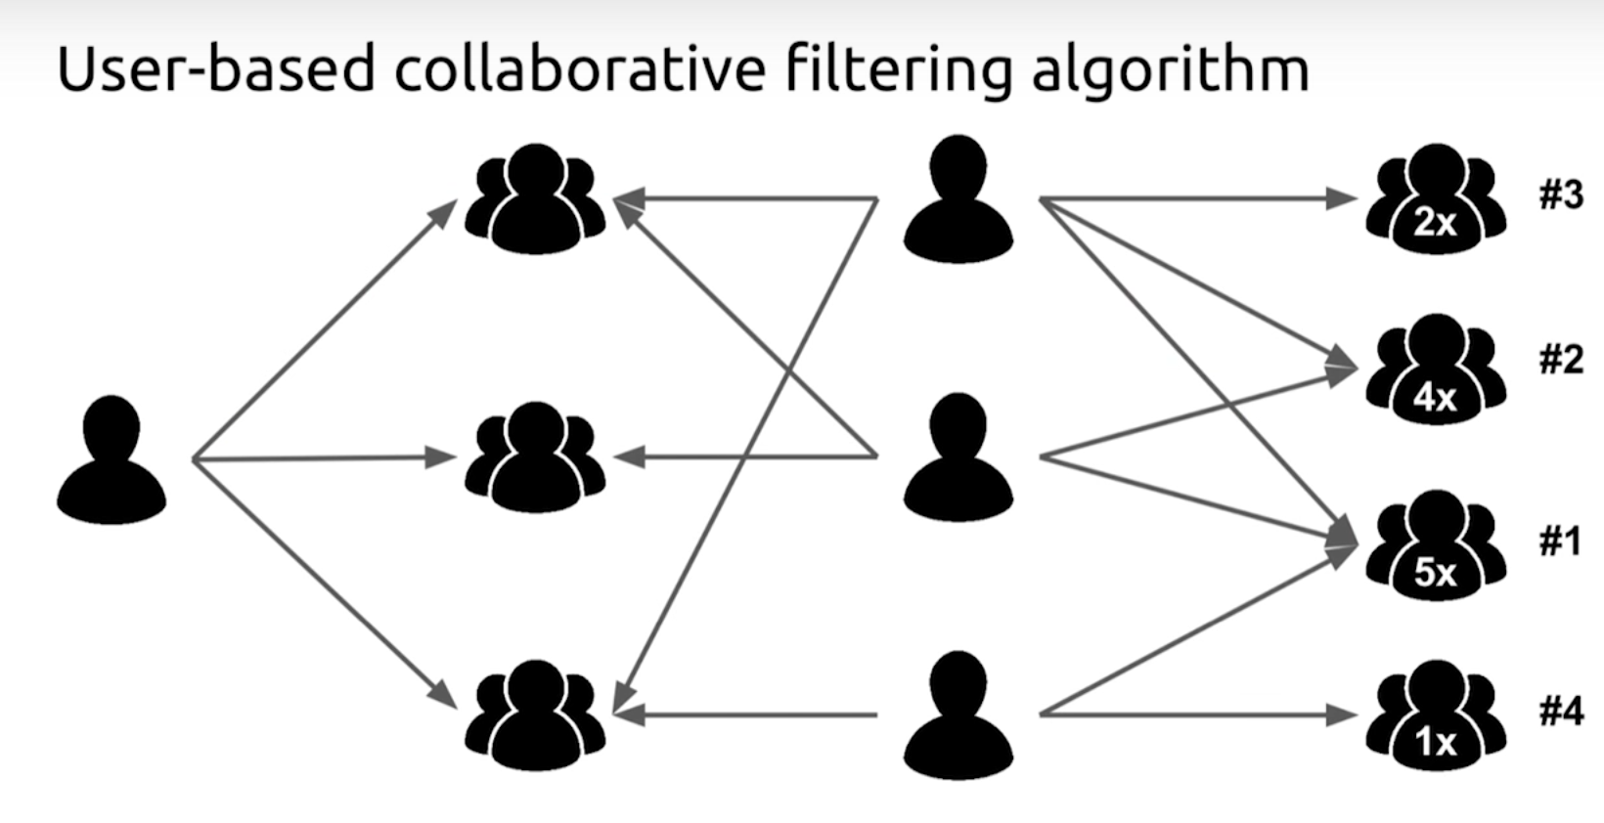
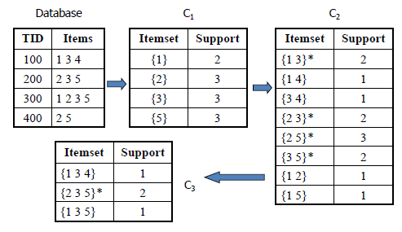
Techniques
Association Rules Mining, Apriori
Algorithm
Questions
Results
Collaborative Filtering
Algorithm
Questions
Results
Figure1: Collaborative Filtering
Figure2: Association Rules Mining
Notes:
The techniques we chose for this project are very different (Point to the two figures) and are utilised in unrelated scenarios - shopping basket analysis, recommendation systems, we chose this because this allows us to learn more about data mining as a whole rather than one particular part of data mining for one particular scenario.

Slide 4
Association Rules Mining
Apriori Algorithm is one of many algorithms for Association Rules Mining, other popular examples are the Eclat Algorithm, OPUS Search and FP-growth algorithm. We chose to work with Apriori because it is a standard and simple method for association rules mining and is also the one we are most familiar with.
- Online Retail – Used for both the algorithm written from scratch and the algorithm written with the MLextend Library.
- Groceries – Much smaller dataset, no cleaning required, very simple to work with when building an Association Rules Mining algorithm.

Slide 5
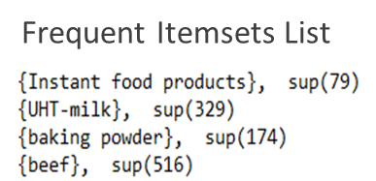
Questions
How many unique items are there?
Which items are very often bought together
Are there any associations in the dataset/s with high confidence?
How many association rules have high confidence?
Rules List
Notes:
This is a list of questions we thought would be interesting to answer for the generated frequent itemsets and association rules.
Under the questions, examples of the information extracted is given by showing the first 4 rows of the rules and itemsets output files.

Slide 6
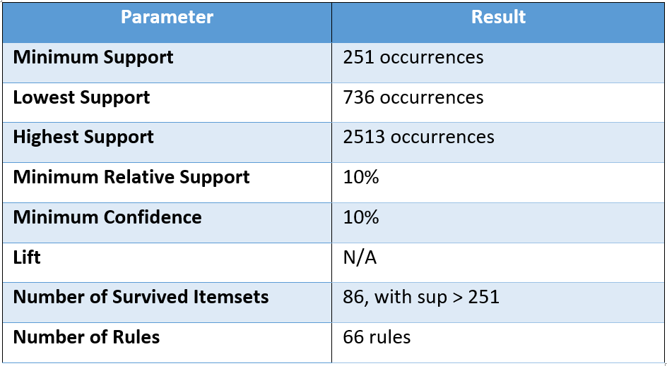
Results - Grocery Shopping Association Rules
169 unique items, with highest frequency 2513 for whole milk and lowest frequency – 1 for baby food.
When given 10% relative support and 10% confidence barrier, the lowest support that passes the boundary is 736, with 86 unique itemsets and 66 unique associations between them.
Highest and Lowest Frequency Items
Figure3: Grocery Shopping Association Rules
Notes:
For this algorithm we have successfully extracted information about the frequent itemsets and their associations.
We have discovered there are 169 unique items, out of which thousands of possible rules can be generated.
The confidence and support boundaries make it possible to filleter out the unpopular itemsets and uncommon rules leaving only those that have the requested impact, as shown on Fig. 3.
Only the itemsets with 251 number of occurrences/support are considered for the association rules mining and even the association rules generated can be filtered by setting the minimum confidence boundary.

Slide 7
Collaborative Filtering
Collaborative Filtering (Library)
Surprise library has been developed to make recommendation based on Collaborative filtering to predict user rating for a movie, also Nearest neighbour it’s a popular approach. In this data set we used Surprise library since it has default implementation for a variety of CF algorithms.
- Movielands: This dataset (ml-latest-small) describes 5-star rating a movie recommendation service. It contains 100836 ratings and 3683 tag applications across 9742 movies. These data were created by 610 users between March 29, 1996 and September 24, 2018. This dataset was generated on September 26, 2018.Users were selected at random for inclusion. All selected users had rated at least 20 movies. No demographic information is included. Each user is represented by an id, and no other information is provided.
Notes:
The algorithm has been developed both from scratch and with the Surprise Library to make recommendation based on Collaborative Filtering and predict user rating for a movie.
The attributes of Movielands data set is:
User Ids: Movielands users were selected at random for inclusion
Movie Ids: Only movies with at least one rating or tag are included in the dataset.
Ratings: Each line of this file after the header row represents one rating of one movie by one user.
Also Ratings are made on a 5-star scale, with half-star increments (0.5 stars - 5.0 stars).

Slide 8
Questions
Find the average rating and number of ratings for the movie?
Find the predicted rating?
Notes:
Question1: To find the average rating of each movie. To do so, we grouped the dataset by the title of the movie and then calculate the mean of the rating for each movie. Then we sorted the ratings in the descending order of their average ratings, then we have added the number of ratings for a movie to the ratings_mean_count data frame.
Question2: As in many other Machine Learning algorithms training is used to optimize its predictions to match as closely as possible the actual results. So, in the context of collaborative filtering, our algorithm will try to predict the rating of a certain user-movie combination and it will compare that prediction to the actual prediction. The difference between the actual and the predicted rating is measured using classical error measurements such as Root mean squared error (RMSE) and Mean absolute error (MAE).

Slide 9
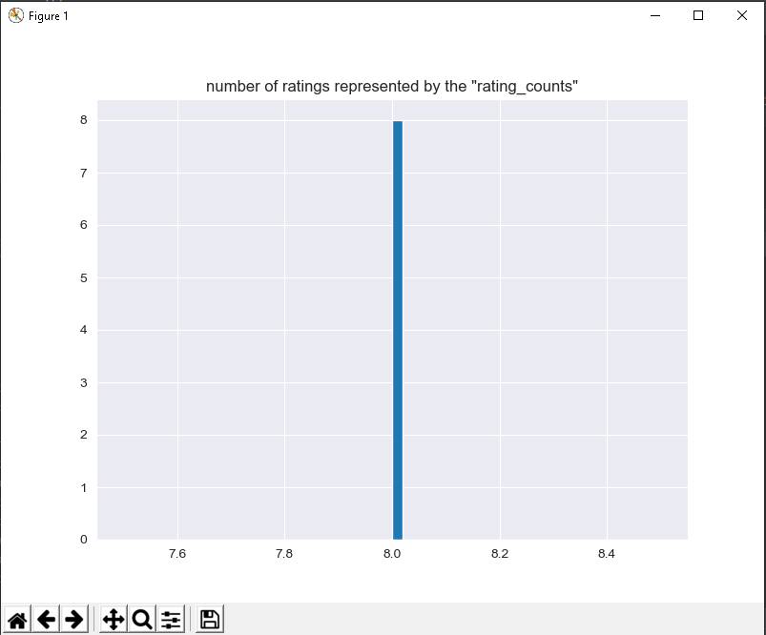
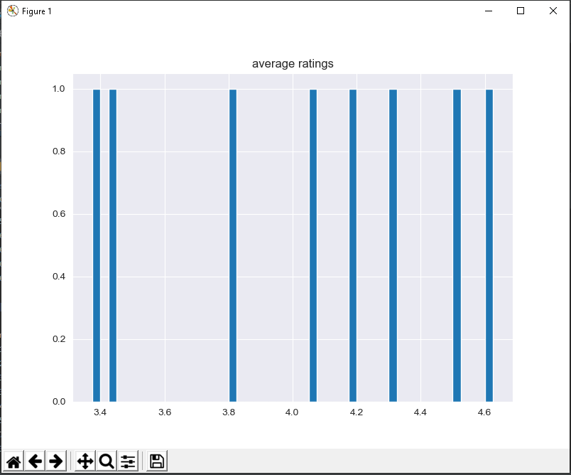
Results – Movie Ratings
Figure4: average ratings
Figure5: number of ratings represented by the "rating_counts
Notes:
The output in figure 4, clearly shows that most of the movies have received 8 ratings. To view the average ratings for each movie, we have plotted a histogram chart as showing in Figure 5.

Slide 10
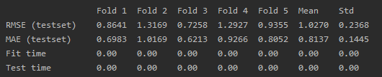
Results – Cross Validation and Predictions
Optimization:
Predicting:
Notes:
Optimization: displays the performance of our algorithm through the use of 5-fold Cross Validation.
Predicting: Finally, we are interested in the predicted rating for a certain user-movie combination so we know whether the user will like this movie or not.
And from the results we can see that the estimated rating is 4.04 compared to the actual rating of 5 as displayed.

